Slide 1
WHAT IS THE EFFECT OF EARTH’S TEMPERATURE ON CYCLONIC STORMS?
Please note graphs are interactive and only works in RMarkdown when you hover over the graph.
Enid Roman - Data 608 – Story 5

Slide 2
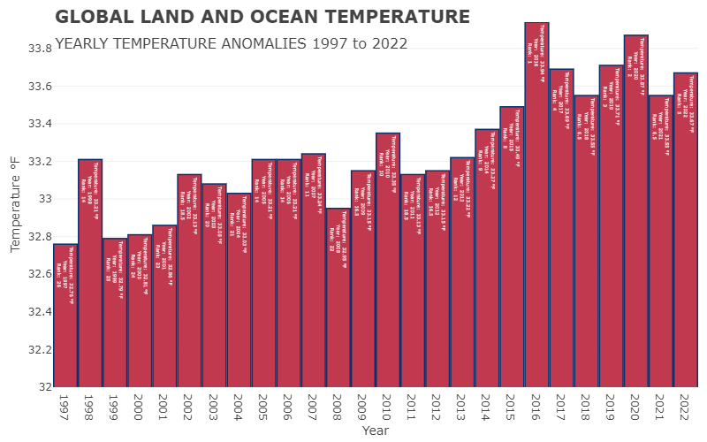
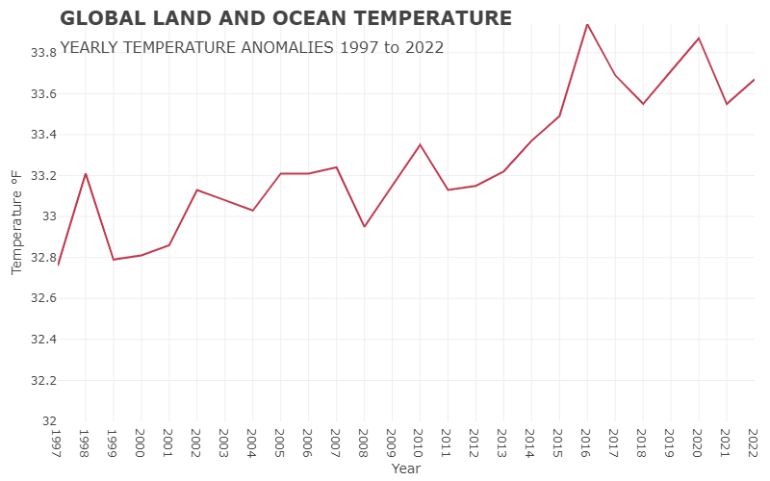
Global Land and Ocean Temperature Yearly Temperature Anomalies 1997 to 2022
A "temperature anomaly" is when the actual temperature is different from what's usual or average. A positive anomaly means it's warmer than usual, and a negative anomaly means it's cooler than usual.
Highest Temperature for the past 25 years is 33.94 F in 2016
Temperature has been increasing overtime.
Reference: https://www.ncei.noaa.gov/access/monitoring/climate-at-a-glance/global/time-series/globe/land_ocean/12/9/1998-2023?trend=true&trend_base=100&begtrendyear=1998&endtrendyear=2023

Slide 3
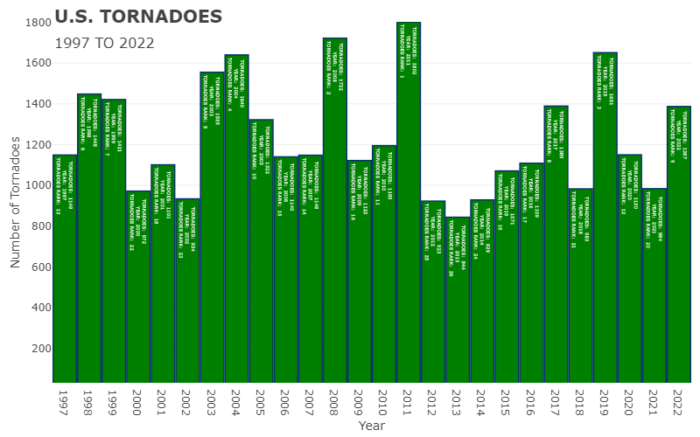
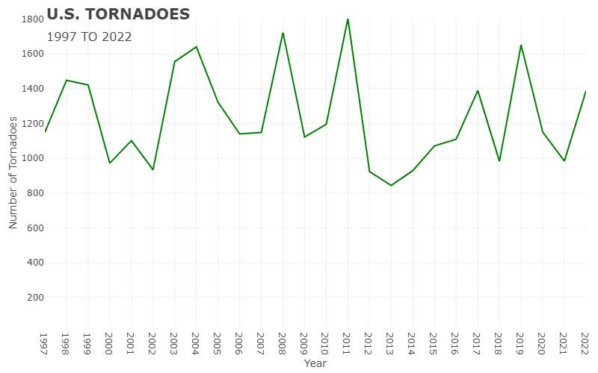
U.S. Tornadoes 1997 to 2022
Highest Tornado count for the past 25 years is 1802 in 2011
The total amount of tornadoes has been fluctuating over the past 25 years
reference: https://www.ncei.noaa.gov/access/monitoring/tornadoes/12/9?fatalities=false

Slide 4
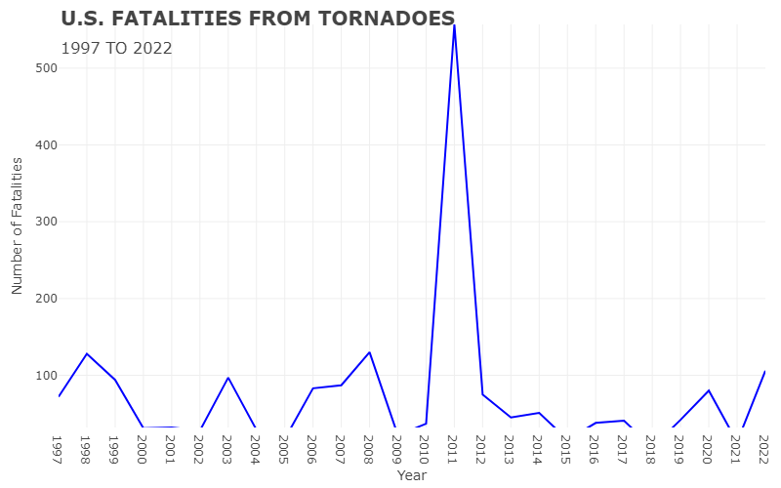
U.S. Fatalities from Tornadoes 1997 to 2022
Highest Tornado count for the past 25 years is 1802 in 2011
Highest fatalities from Tornadoes was 557 in 2011
reference: https://www.ncei.noaa.gov/access/monitoring/tornadoes/12/9?fatalities=false

Slide 5
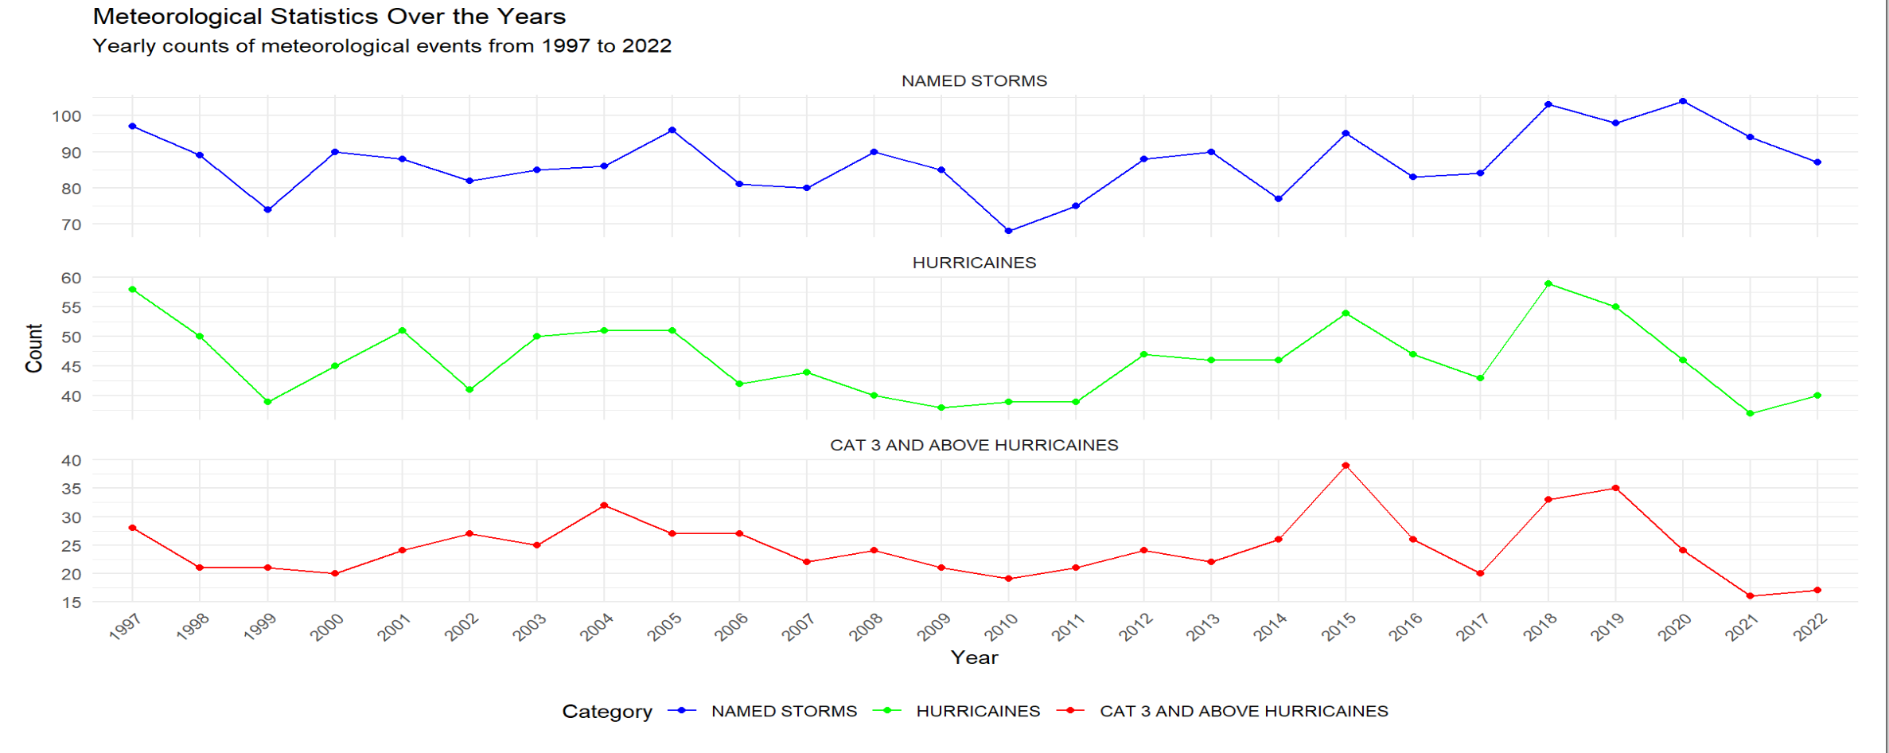
Over the past 3 years there has been a drop of numbers of hurricanes even though there has been increase in name storms. Cat 3 + has also decreased.
The greatest count of Named Storms in the past 25 years at 104 in 2020
The greatest count of Hurricanes in the past 25 years at 103 in 2018
The greatest count of Cat 3 + Hurricanes in the past 25 years at 39 in 2015
References: https://tropical.atmos.colostate.edu/Realtime/index.php?arch&loc=global

Slide 6
Is Temperature effecting the number of tornadoes we have been getting over the past 25 years?
Temperature has increased over the past 25 years.
The total amount of tornadoes has been fluctuating over the past 25 years.

Slide 7
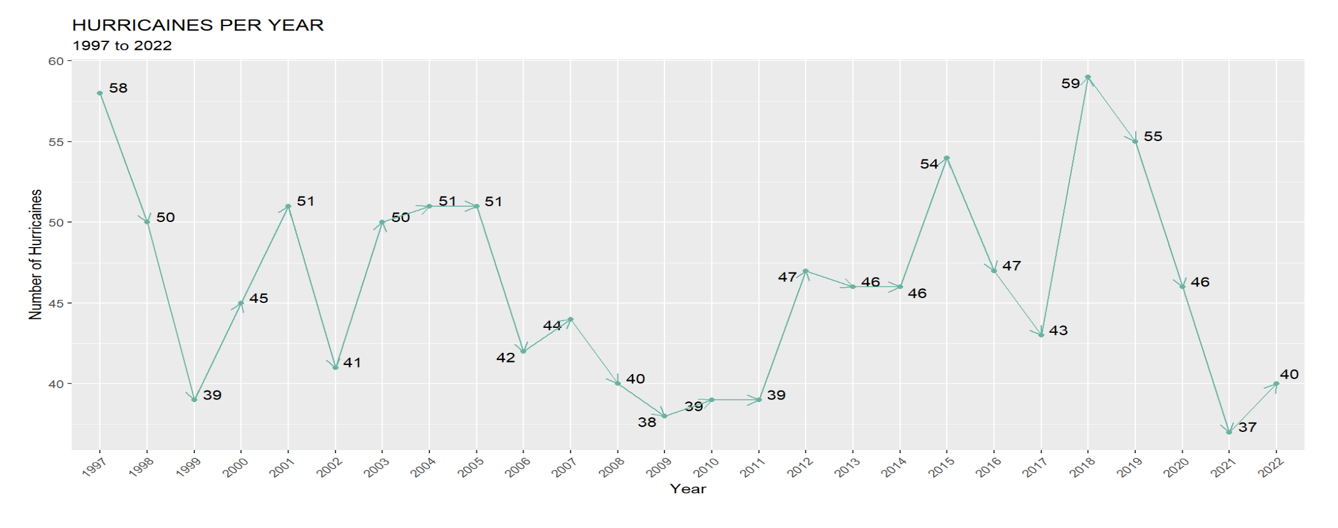
Is Temperature effecting the number of hurricanes we have been getting over the past 25 years?
Temperature has increased over the past 25 years.
The numbers of hurricanes has dropped over the past 25 years.

Slide 8
Is Temperature effecting the number of hurricanes, named storms, and cat 3+ hurricanes we have been getting over the past 25 years?
Temperature has increased over the past 25 years.
Over the past 3 years there has been a drop of numbers of hurricanes even though there has been increase in name storms. Cat 3 + has also decreased

Slide 9
Appendix

